Slide 1
Preparing for RCRA inspections
Lauren Blazeck
October 30th, 2018
Notes:
Hi Everyone, my name is Lauren Blazeck and I’ll be speaking to you all today about how Intel prepares for and responds to agency inspections (specifically RCRA). I work at the Intel Ocotillo campus, which is our High Volume Manufacturing Facility. This site has fabrication plants where we make semiconductors.

Slide 2
Agenda
Background and types of agency inspections
Intel preparation for RCRA inspections
Intel response to RCRA inspections
Helpful resources
Automation: how it can help
Notes:
This is the agenda for my presentation today. First I’ll speak to you about the background of RCRA and different types of agency inspections you can expect at your site. Then I’ll speak about Intel preparation for and response to RCRA inspections. Then I’ll go over some helpful resources that may assist you and your facility to prepare for agency inspections. Lastly, I’ll speak about automation and you can use it to your advantage to prepare for inspections.

Slide 3
Background and types of Agency Inspections

Slide 4
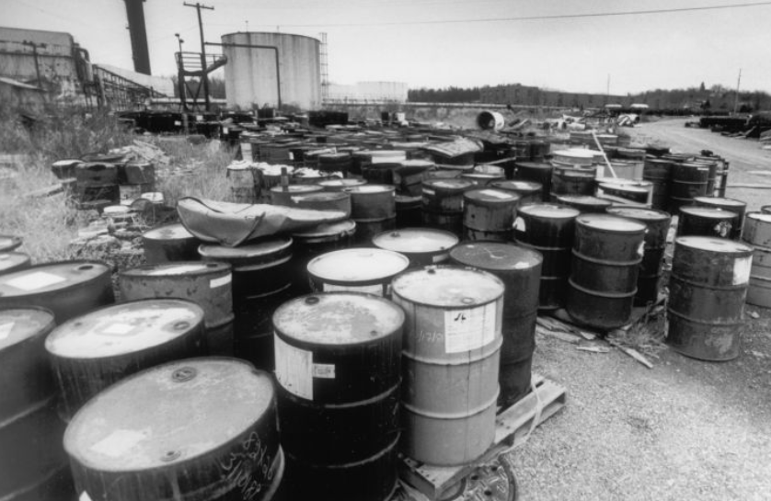
RCRA background
RCRA: Resource Conservation and Recovery Act of 1976
Establishes the framework for USA’s solid waste control and regulations
Based on the Solid Waste Disposal Act of 1965
Picture: Superfund site in Front Royal, VA.
Facility is Avtex Fibers, shut down in 1989.
Notes:
Some general background about RCRA. RCRA standards for Resource Conservation and Recovery Act. This act was enacted in 1976 and based on the solid waste disposal act of 1965. This was passed by congress due to the increasing volume of municipal and industrial waste.
The goal of RCRA is to protect human health and the environment from the hazards of improper waste disposal, to conserve energy and natural resources, and to reduce the amount of was generated by recycling .
This picture is an example of one of the challenges the government faced due to increasing volumes of industrial waste. This is a superfund site that was shutdown in 1989. Some of the drums were empty, and some contained waste. The regulations in RCRA establish a framework for waste disposal so industrial facilities cannot dispose of their waste in this manner.

Slide 5
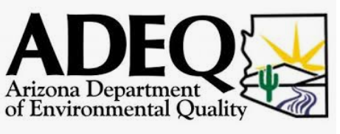
agency inspections
Agency bodies for RCRA inspections:
Arizona Department of Environmental Quality (ADEQ) and Environmental Protection Agency (EPA)
Types of inspections:
Regulatory agency visit
Post incident inspection
Inspection due to complaint
Notes:
There are two agency bodies that inspect for compliance to RCRA in Arizona: the Environmental Protection Agency and Arizona Department of Environmental Quality. ADEQ has the authority under RCRA to monitor and direct business that may generate, transport, and dispose of hazardous waste in AZ.
There are a few reasons that an agency may come to your site. The first is a regulatory agency visit, which may be announced or unannounced. This visit may focus on specific areas of your facility or may focus on the entire facility. Another type of agency visit is a post incident inspection. This may be because there was an incident at your site that required reporting to the National Response Center. The last type of common agency inspection is an inspection due to a compliant. For example, if a community member notifies the EPA or ADEQ that they suspect something is improper at your facility the agency may come to inspect.

Slide 6
Intel preparation for RCRA inspections

Slide 7
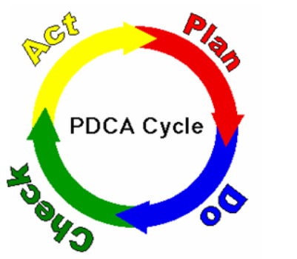
Preparation for RCRA inspections
Intel is an ISO 14001 certified company
Plan-Do-Check-Act: same as ISO/ the scientific method!
Plan: Identify problem, create hypothesis
Do: Develop and complete test method for hypothesis
Check: Evaluate test method and results
Act: Implement the results
Notes:
Intel’s preparation for RCRA inspections involves the Plan-do-check-act method. Purpose of plan do check act is quality control
This method is recommended by ISO and similar to the scientific method. The first step is Plan: identify problem and create hypothesis; DO: develop and complete test method for hypothesis; check: evaluate test method and results; and act: implement the results. Intel uses this process often to ensure we are in compliance. One example of this is our Corporate Audits, which I’ll speak about later.
Plan do check act is part of our environmental management system

Slide 8
Corporate Standards
Goal: to standardize how all Intel sites approach inspections so results can be compared
Intel policies
Roles and Responsibilities
Documentation
Notes:
We also have Corporate Standards. Corporate standards standardize how all Intel sites approach inspections so results can be compared.
The standards review Intel policies, roles and responsibilities, and documentation. Documenting something like the roles and responsibilities in an inspection is important! This is because inspections can be stressful to employees and as an industry employee you want to ensure they go as smoothly as possible.
An example of the “roles and responsibilities” at an Intel agency inspection are:
Site EHS rep: Escort agency inspectors or their designees on Intel property (whether leased or owned). Coordinate the requested activities
Agency inspection “buddy”: Assist in obtaining requested information and to contact the appropriate Intel personnel as needed so that the agency representative is always escorted by the Intel representative.
Management (EHS): Ensure proper notifications are made and inspection is properly documented

Slide 9
Corporate Audits
Goal: to mimic and prepare for agency inspections
Intel’s Corporate Audit Team:
Physical walks of storage areas and tank systems
Documentation
Training records
Prior audit findings
Interview employees: program owners, technicians, management, etc.
Notes:
Another thing Intel does to prepare for RCRA inspections is complete Corporate Intel Audits. Completed once every two years at large manufacturing sites.
Who is on the team? Legal rep, Corporate: IH, safety, occupational health, environmental, and fire protection
Pros and cons for same people completing the audit:
Pros:
repeatability! The same level of concern will be directed across your company.
Experience! Audit team members can 100% focus on the audit. No other obligations during audit
Cons:
Different people will look for different items and view a system with a new light. We handle this by having the audit team switch what programs they are auditing, and having 2 people audit together. A team of people will have a more comprehensive audit.

Slide 10
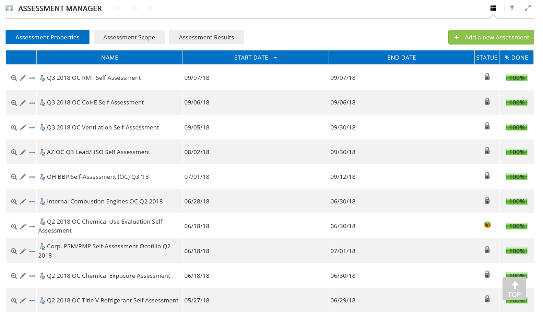
Self-assessments
Goal: for program owners to assess compliance and share learnings
Frequency: determined by Corporate. Typically 1x per yr. or 1x per 2 yr.
Intel uses ENABLON to manage compliance and self-assessments: https://enablon.com/
Notes:
Another thing Intel does to prepare for agency inspection is have the program owners complete self-assessments. The goal of self-assessments is for program owners to assess the compliance of their programs and to share learning with other Intel sites. The frequency of these self-assessments is determined by Corporate EHS and Legal. Usually 1-2x per year.
The picture is a screenshot of Enablon, which Intel uses to manage compliance for many of our EHS programs. This section is the assessment manager which focuses on self-assessments. On the left we have the self-assessment title, then the start and due date, and then the percentage of the assessment that has been completed.
Corporate owners can pull information and determine if there are trends across sites
Talk about how this leads to findings and then related action plans!!

Slide 11
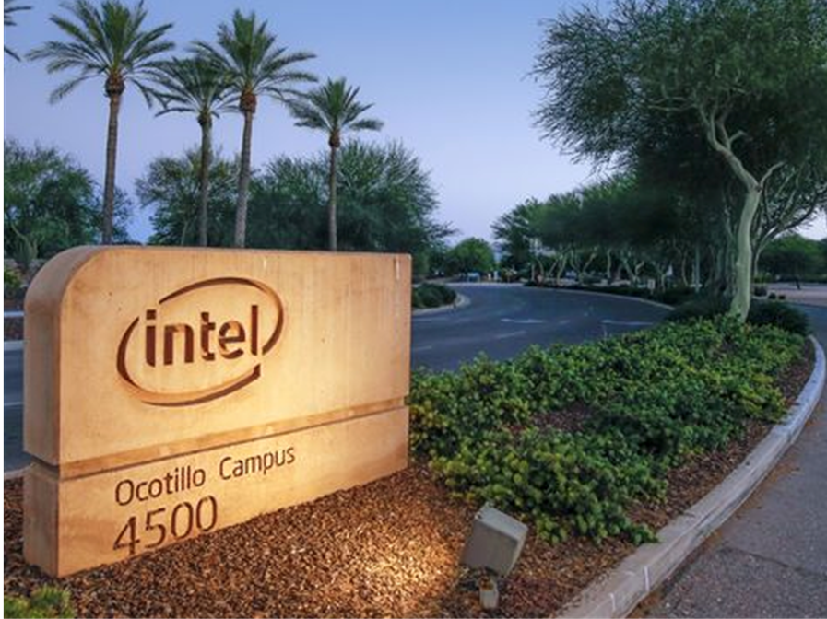
Ocotillo site goals
Ensure: Preparation, communication, and standardization
Notes:
In general, Intel’s goal for compliance and agency inspection is to ensure we are prepared, we communicate, and our approach to inspections is standardized.

Slide 12
Intel response to RCRA inspections

Slide 13
Pre- and post-conference
Recommended to have a pre- and post-conference with the agency:
Opening conference:
Understand purpose of visit
Discuss how to handle IP
Review safety procedures
Closing conference:
Document findings and suggestions from agency
Notes:
During an inspection Intel likes to have a pre and post conference with the inspecting agency. This allows the agency and the industry to get acquainted.
Opening:
Purpose
How to handle Intellectual property areas.
Safety procedures, PPE require, etc.
Closing:
Discuss and document findings and suggestions from the agency

Slide 14
Opening conference checklist
Date and who (agency and Intel) attended
opening conference
Purpose of inspection, requested records, and IP documentation
Safety requirements for facility

Slide 15
Closing conference checklist
Date and who (agency and Intel) attended
closing conference
Document alleged violations and steps to close potential deficiencies
Additional requested records and due date

Slide 16
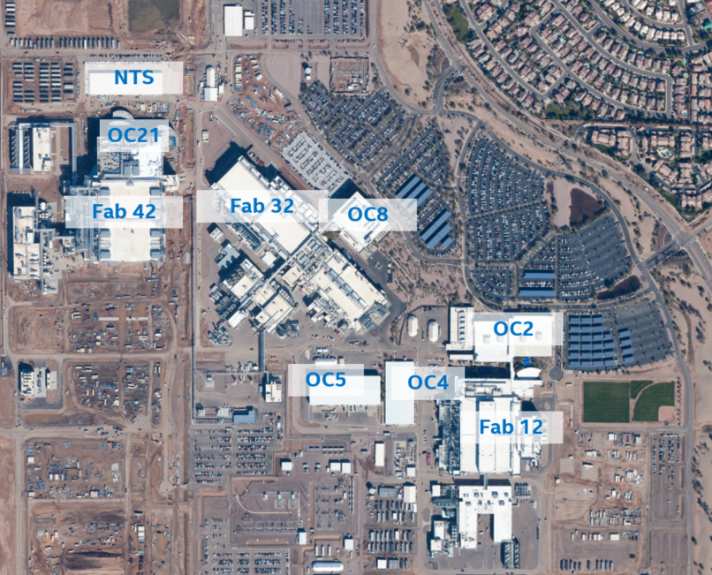
Checklist of items for inspections
Recommended items:
Designated meeting areas
Office supplies: clipboard, notebook, pen, business cards
Intel standardized checklists for opening and closing conferences
Site map
Camera, batteries
Two-way communication device
Intel Ocotillo Site Map
Notes:
We also have a list of recommended items for inspections. This is because inspections can be stressful and you want to ensure you are prepared. For example, you don’t want to be far from your desk and realize you forgot something to write on.
Recommended items are:

Slide 17
Helpful resources

Slide 18
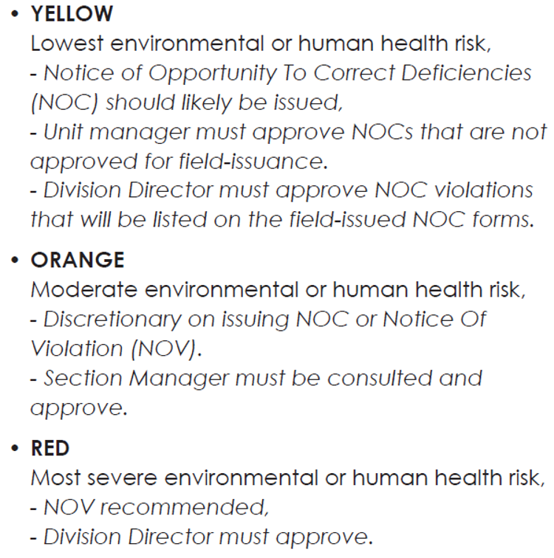
Helpful resources
From ADEQ Compliance Handbook:
ADEQ has information readily available!
ADEQ Large Quantity Generator Hazardous Waste Inspection Checklist
ADEQ Compliance Handbook
A.R.S. 41-1009: Inspections and audits; applicability, exceptions
Notes:
ADEQ Large Quantity Generator Hazardous waste inspection checklist:
Has checklist of compliance items with regulatory citation
Facility information (EPA ID, ADEQ registration, fee payment)
Waste determinations/generator status
Treatment, Storage, and Disposal
Hazardous waste 90-day storage area
Hazardous Waste satellite accumulation areas
Universal Waste
Contingency plan
Personnel training
Inspection checklists
Manifests
Land disposal restrictions
Waste Minimization and Pollution Prevention Plan
Spill Reports
ADEQ compliance handbook: reviews ADEQ procedures for facility inspections
Have a published ranking system:

Slide 19
How automation can help
Notes:
I wanted to spend a little time discussing how we can use automation to our advantage to ensure we are prepared as a site for internal and agency inspections.

Slide 20
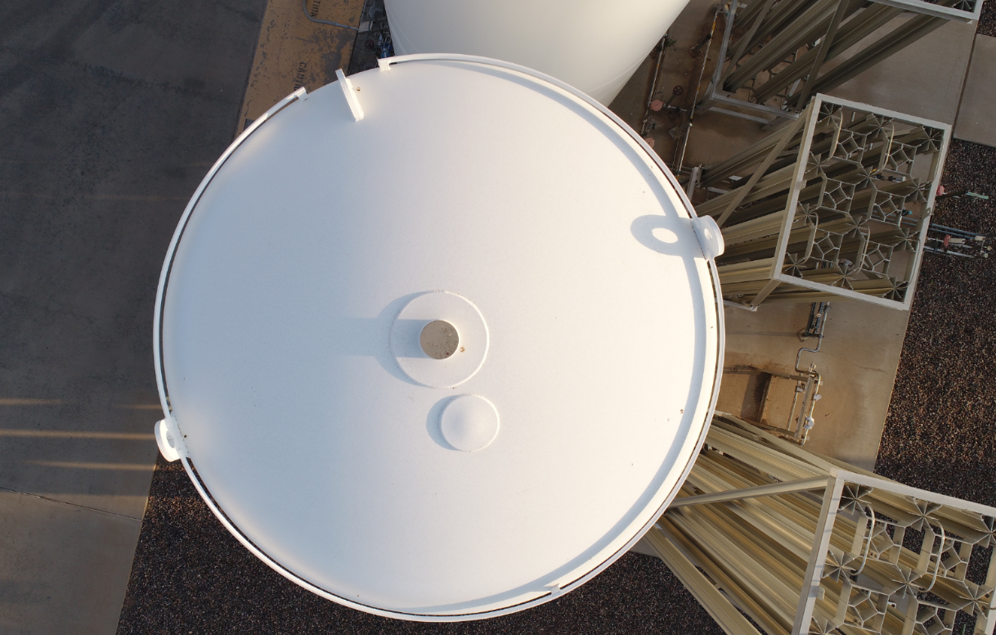
Drones to inspect equipment: 4K pictures
Tank inspection: can evaluate equipment condition (rust, corrosion) over time
Notes:
We use drones often at our campus to help with equipment inspections. Many drones have 4K cameras, which means that you can take a picture from far away and zoom in and still have really good quality pictures.

Slide 21
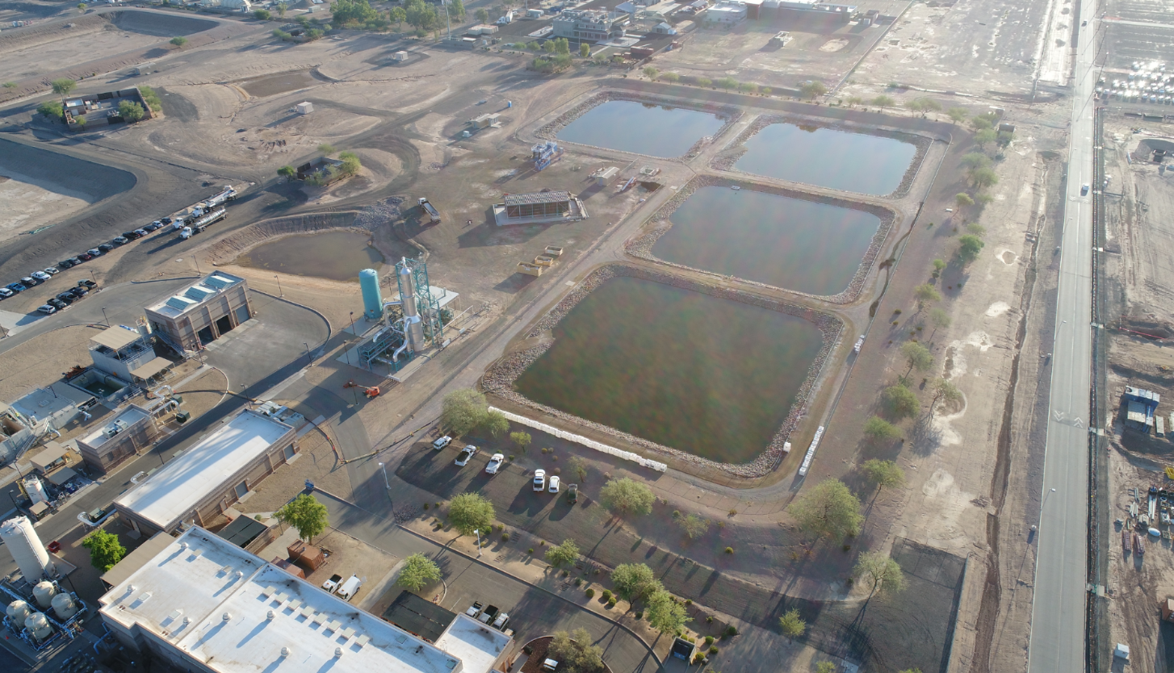
Notes:
Here is another picture from our site. These ponds are brine ponds, and drones can be used to inspect condition of these ponds over time.

Slide 22
Intel Insight Platform
Notes:
Intel recently released a platform for drone picture and resulting 2D and 3D models. Intel Insight is a platform that allows you to view pictures of an area over time. This platform can also create 2D and 3D models of an area using pictures from a drone

Slide 23
Platform allows you to view pictures taken at different times of the same area, comment about pictures, create 2-D and 3-D models, overlap with Google Maps, measure distances and heights of objects, etc.

Slide 24
Thank you!!
Intel Drone Team: Thomas Gilman
Skip Benjes
Intel Ocotillo EHS: Sean Aldrich, Craig McCurry

